Slide 1
Advanced Encryption Standard (AES)

Slide 2
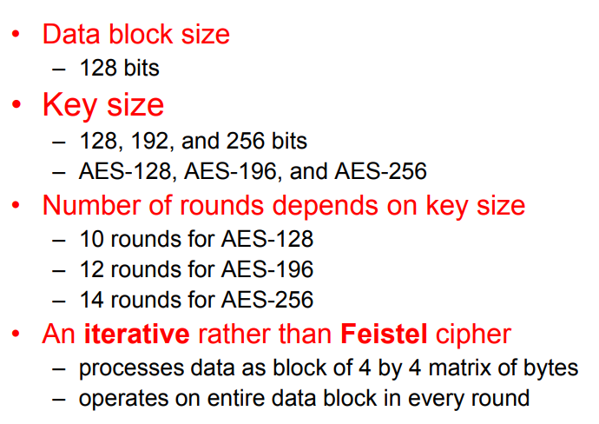
Advanced Encryption Standard

Slide 3
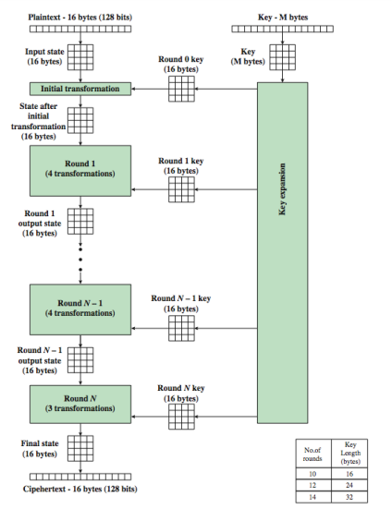
Advanced Encryption Standard(AES)

Slide 4
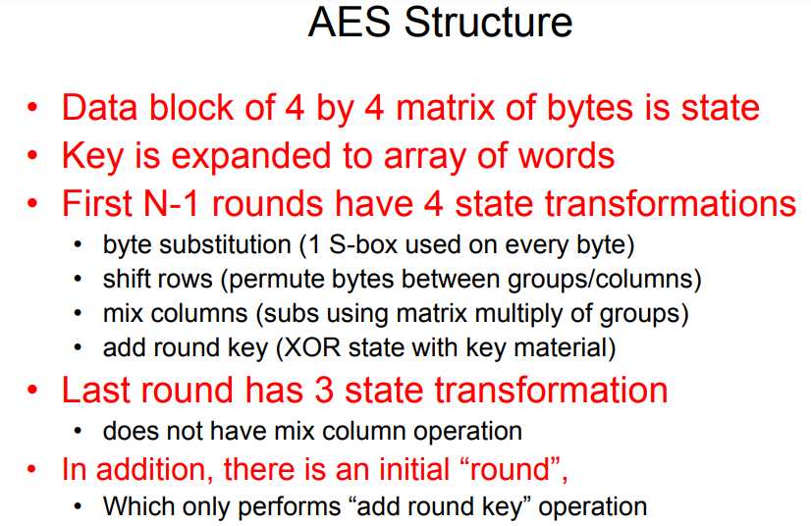

Slide 5
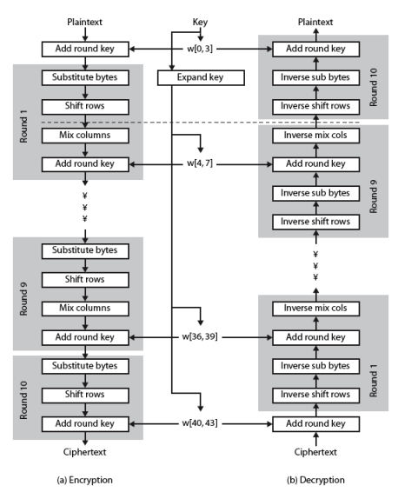
AES Structure

Slide 6
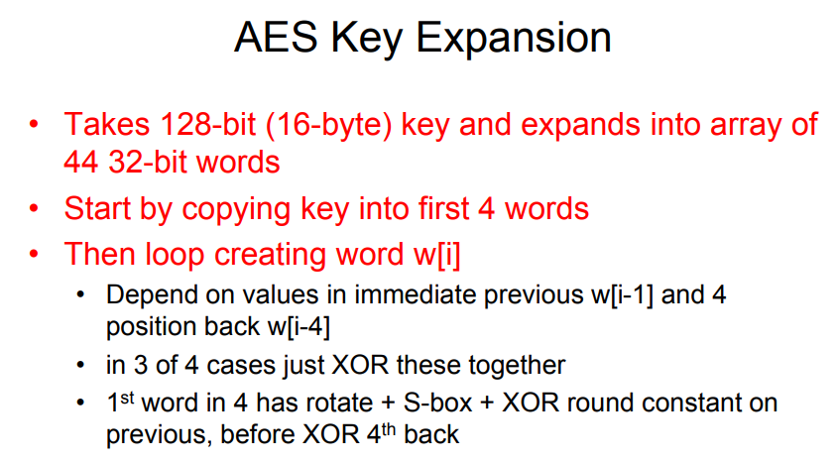

Slide 9
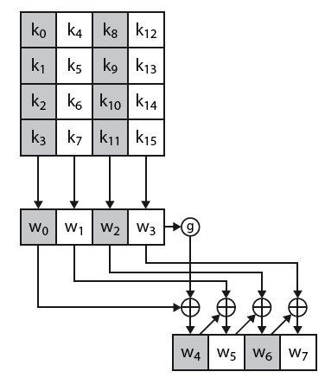
AES key Expansion

Slide 12
